Slide 1
Rendering Volumetric Scattering
CS184
Kaifei Peng, Ruixin Huang, Jinrui Zhang

Slide 2
In Project 3
Light
Camera

Slide 3
In Project 3
Light
At_least_one_bounce
Camera

Slide 4
In Project 3
Light
Estimate direct
illumination
Camera

Slide 5
In Project 3
Light
Camera
At_least_one_bounce

Slide 6
In Project 3
Light
Estimate direct
illumination
Camera

Slide 7
In Project 3
Light
EstRadiance(){
return zero_bounce()
+at_least_one_bounce()
Camera

Slide 8
In Final Project
Light
Camera

Slide 9
In Final Project
Light
At_least_one_bounce
Camera

Slide 10
In Final Project
Light
Estimate direct
illumination (scattering)
Camera

Slide 11
In Final Project
Light
Camera

Slide 12
In Final Project
Light
Camera

Slide 13
In Final Project
Light
Camera

Slide 14
In Final Project
Light
Camera

Slide 15
In Final Project
Light
Camera

Slide 16
In Final Project
Light
Estimate direct
illumination (reflecting)
Camera

Slide 17
In Final Project
Light
EstRadiance(){
return zero_bounce()
+at_least_one_bounce()
Camera

Slide 18
In Final Project
Light
EstRadiance(){
return zero_bounce()
+at_least_one_bounce()
Camera
Terminated by Russian Roulette
or max Ray depth

Slide 19
In Final Project
Tracing Ray
Particle

Slide 20
In Final Project
Direct illumination estimating of a scattering event
$$θ$$
Particle
$$∫_{4π}P(ω_{i},θ)L(θ)dθ$$

Slide 21
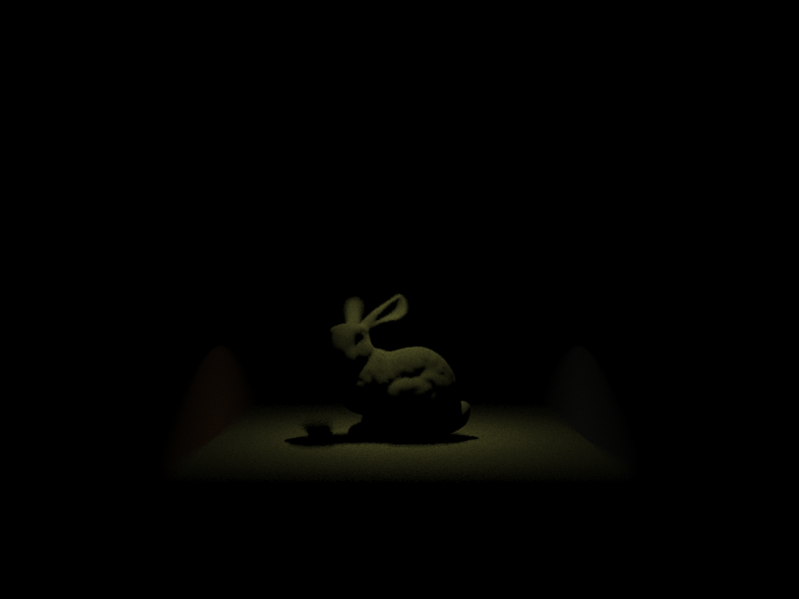
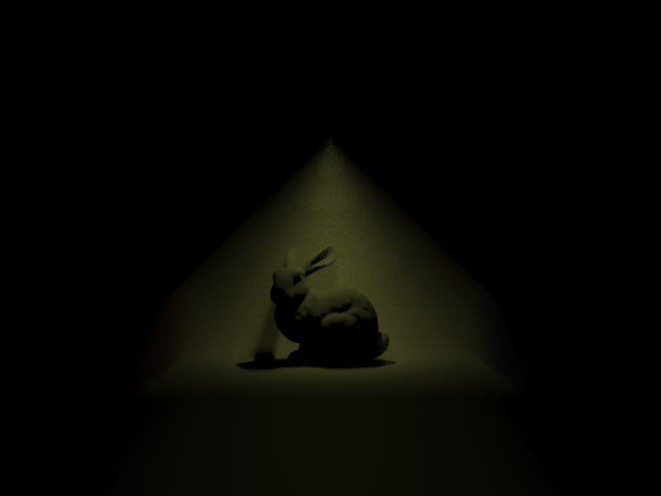
Project 3
Final Project

Slide 22
